Slide 1
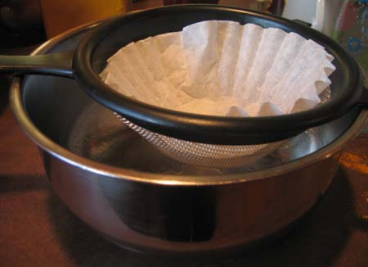
Image Filtering

Slide 2
Overview of Filtering
Convolution
Gaussian filtering
Median filtering

Slide 3
Overview of Filtering
Convolution
Gaussian filtering
Median filtering

Slide 4
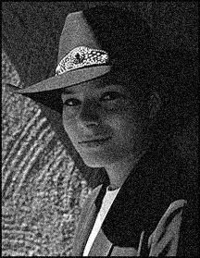
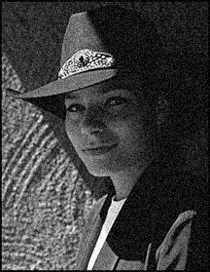

Motivation: Noise reduction
Given a camera and a still scene, how can you reduce noise?
Take lots of images and average them!
What’s the next best thing?
Source: S. Seitz
Notes:
Answer: take lots of images, average them

Slide 5

Moving average
Let’s replace each pixel with a weighted average of its neighborhood
The weights are called the filter kernel
What are the weights for the average of a 3x3 neighborhood?
1
1
1
1
1
1
1
1
1
“box filter”
Source: D. Lowe

Slide 6
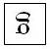
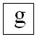
Defining Convolution
Let f be the image and g be the kernel. The output of convolving f with g is denoted f * g.
f
Convention: kernel is “flipped”
MATLAB: conv2 (also imfilter)
Source: F. Durand

Slide 7
Key properties
Linearity: filter(f₁ + f₂ ) = filter(f₁) + filter(f₂)
Shift invariance: same behavior regardless of pixel location: filter(shift(f)) = shift(filter(f))
Theoretical result: any linear shift-invariant operator can be represented as a convolution

Slide 8
Properties in more detail
Commutative: a * b = b * a
Conceptually no difference between filter and signal
Associative: a * (b * c) = (a * b) * c
Often apply several filters one after another: (((a * b₁) * b₂) * b₃)
This is equivalent to applying one filter: a * (b₁ * b₂ * b₃)
Distributes over addition: a * (b + c) = (a * b) + (a * c)
Scalars factor out: ka * b = a * kb = k (a * b)
Identity: unit impulse e = […, 0, 0, 1, 0, 0, …], a * e = a

Slide 9
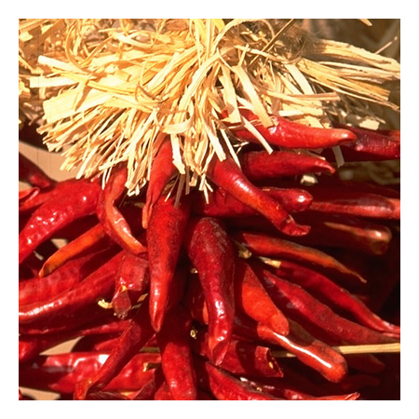


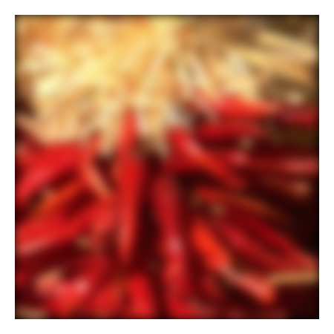


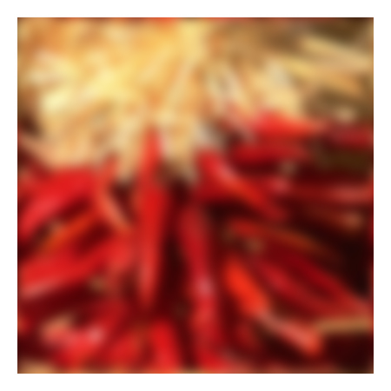






Annoying details
What about near the edge?
the filter window falls off the edge of the image
need to extrapolate
methods:
clip filter (black)
wrap around
copy edge
reflect across edge
Source: S. Marschner

Slide 10
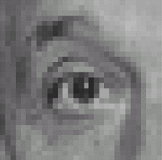
Practice with linear filters
0
0
0
?
0
1
0
0
0
0
Original
Source: D. Lowe

Slide 11
Practice with linear filters
0
0
0
0
1
0
0
0
0
Original
Filtered
(no change)
Source: D. Lowe

Slide 12
Practice with linear filters
0
0
0
?
0
0
1
0
0
0
Original
Source: D. Lowe

Slide 13
Practice with linear filters
0
0
0
0
0
1
0
0
0
Original
Shifted left
By 1 pixel
Source: D. Lowe

Slide 14
Practice with linear filters
1
1
1
?
1
1
1
1
1
1
Original
Source: D. Lowe

Slide 15
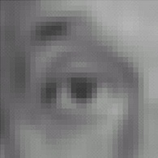
Practice with linear filters
1
1
1
1
1
1
1
1
1
Original
Blur (with a
box filter)
Source: D. Lowe

Slide 16
Practice with linear filters
0
0
0
-
1
1
1
?
0
2
0
1
1
1
0
0
0
1
1
1
(Note that filter sums to 1)
Original
Source: D. Lowe

Slide 17
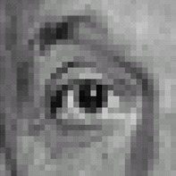
Practice with linear filters
0
0
0
-
1
1
1
0
2
0
1
1
1
0
0
0
1
1
1
Original
Sharpening filter
Accentuates differences with local average
Source: D. Lowe

Slide 18
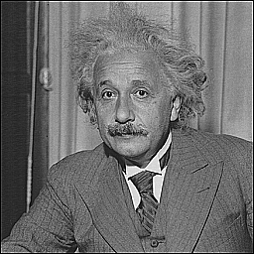
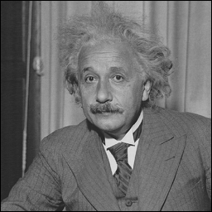
Sharpening
before
after
Slide credit: Bill Freeman

Slide 19
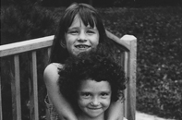
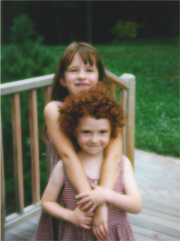
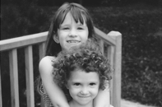
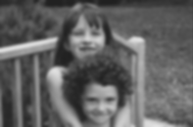

Blurring the G component
R
G
B
original
processed
Slide credit: Bill Freeman

Slide 20


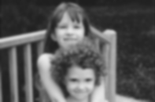
Blurring the R component
R
G
B
original
processed
Slide credit: Bill Freeman

Slide 21
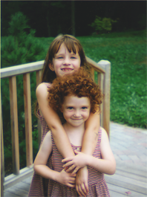
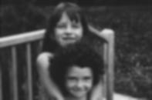
Blurring the B component
R
G
B
original
processed
Slide credit: Bill Freeman

Slide 22
Overview of Filtering
Convolution
Gaussian filtering
Median filtering

Slide 23
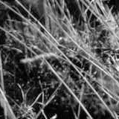
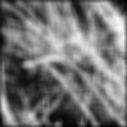
Smoothing with box filter revisited
Smoothing with an average actually doesn’t compare at all well with a defocused lens
Most obvious difference is that a single point of light viewed in a defocused lens looks like a fuzzy blob; but the averaging process would give a little square
Source: D. Forsyth
Notes:
I always walk through the argument on the left rather carefully; it gives some insight into the
significance of impulse responses or point spread functions.

Slide 24
Smoothing with box filter revisited
Smoothing with an average actually doesn’t compare at all well with a defocused lens
Most obvious difference is that a single point of light viewed in a defocused lens looks like a fuzzy blob; but the averaging process would give a little square
Better idea: to eliminate edge effects, weight contribution of neighborhood pixels according to their closeness to the center, like so:
“fuzzy blob”
Source: D. Forsyth
Notes:
I always walk through the argument on the left rather carefully; it gives some insight into the
significance of impulse responses or point spread functions.

Slide 25
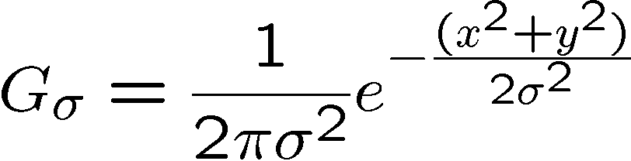
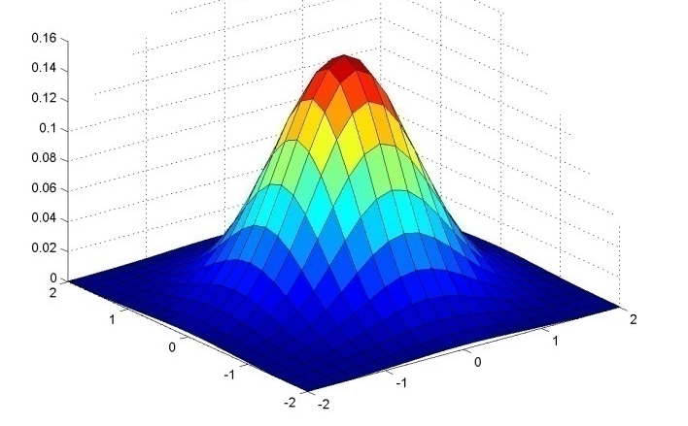
Gaussian Kernel
0.003 0.013 0.022 0.013 0.003
0.013 0.059 0.097 0.059 0.013
0.022 0.097 0.159 0.097 0.022
0.013 0.059 0.097 0.059 0.013
0.003 0.013 0.022 0.013 0.003
5 x 5, σ = 1
Constant factor at front makes volume sum to 1 (can be ignored, as we should re-normalize weights to sum to 1 in any case)
Source: C. Rasmussen

Slide 26
Choosing kernel width
Gaussian filters have infinite support, but discrete filters use finite kernels
Source: K. Grauman

Slide 27
Choosing kernel width
Rule of thumb: set filter half-width to about 3 σ

Slide 28

Example: Smoothing with a Gaussian

Slide 29
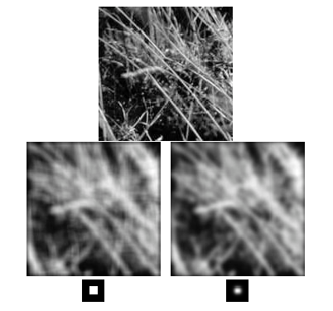
Mean vs. Gaussian filtering

Slide 30
Gaussian filters
Remove “high-frequency” components from the image (low-pass filter)
Convolution with self is another Gaussian
So can smooth with small-width kernel, repeat, and get same result as larger-width kernel would have
Convolving two times with Gaussian kernel of width σ is same as convolving once with kernel of width σ√2
Separable kernel
Factors into product of two 1D Gaussians
Source: K. Grauman
Notes:
Linear vs. quadratic in mask size

Slide 31
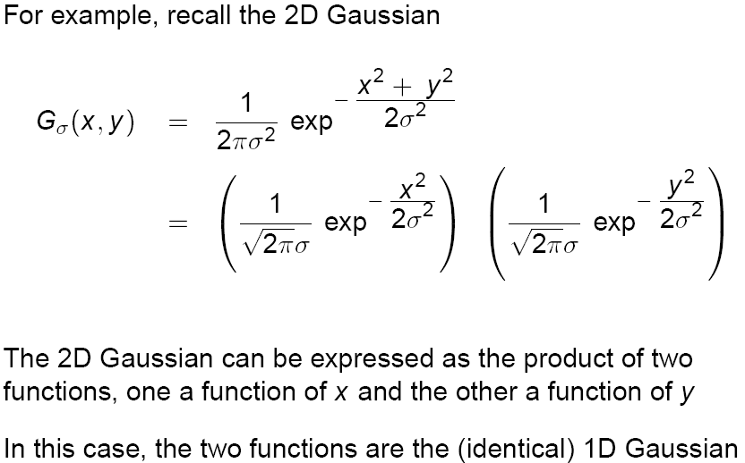
Separability of the Gaussian filter
Source: D. Lowe

Slide 32
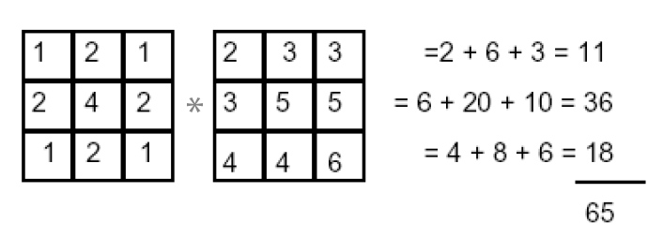
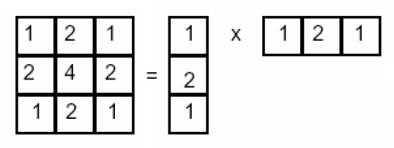
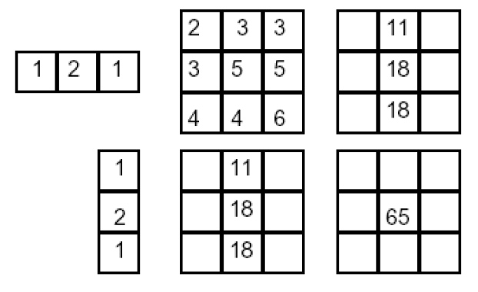
Separability example
2D convolution (center location only)
The filter factors into a product of 1D filters:
Perform convolution along rows:
*
=
Followed by convolution along the remaining column:
*
=
For MN image, PQ filter: 2D takes MNPQ add/times, while 1D takes MN(P + Q)
Source: K. Grauman

Slide 33
Overview of Filtering
Convolution
Gaussian filtering
Median filtering

Slide 34
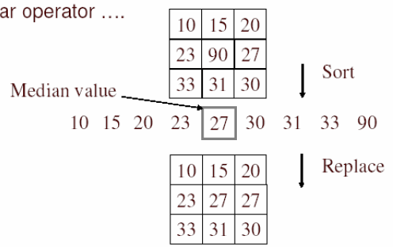
Alternative idea: Median filtering
A median filter operates over a window by selecting the median intensity in the window
Is median filtering linear?
Source: K. Grauman
Notes:
Linearity of median filter: try filter([0 0 0; 0 1 0; 0 0 0] + [1 1 1; 1 1 2; 2 2 2])

Slide 35
Median filter
Replace each pixel by the median over N pixels (5 pixels, for these examples). Generalizes to “rank order” filters.
Median([1 7 1 5 1]) = 1
Mean([1 7 1 5 1]) = 2.8
In:
Out:
Spike noise is removed
5-pixel neighborhood
Monotonic edges remain unchanged
In:
Out:

Slide 36
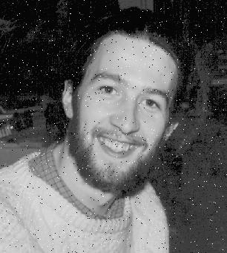

Median filtering results
Best for salt and pepper noise
http://homepages.inf.ed.ac.uk/rbf/HIPR2/mean.htm#guidelines

Slide 37
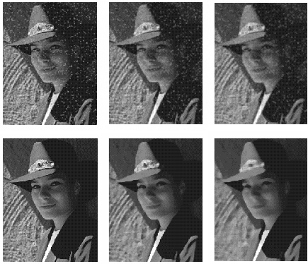
Median vs. Gaussian filtering
3x3
5x5
7x7
Gaussian
Median

Slide 38
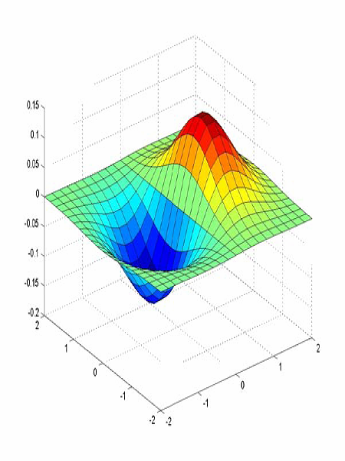
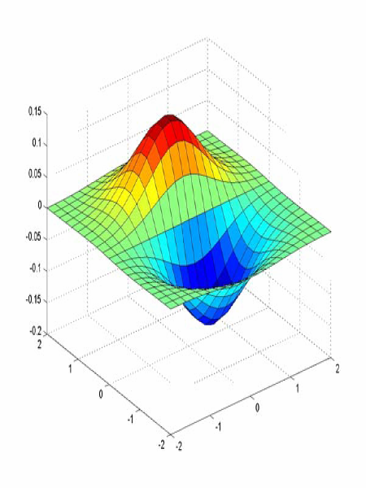
Derivative of Gaussian filter
x-direction
y-direction
Which one finds horizontal/vertical edges?

Slide 39
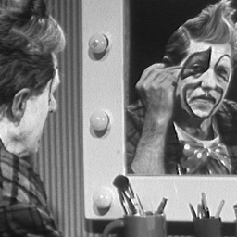
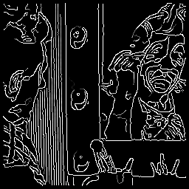
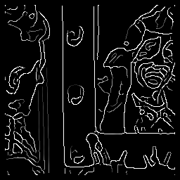
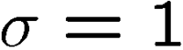
Effect of σ (Gaussian kernel spread/size)
original
Canny with
Canny with
The choice of σ depends on desired behavior
large σ detects large scale edges
small σ detects fine features
Source: S. Seitz

Slide 40
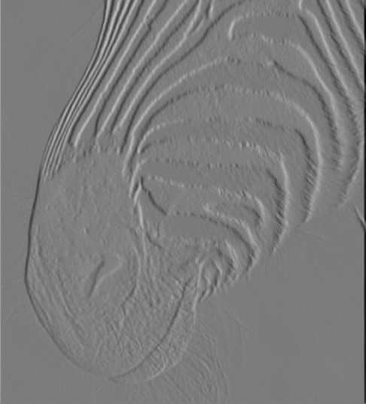
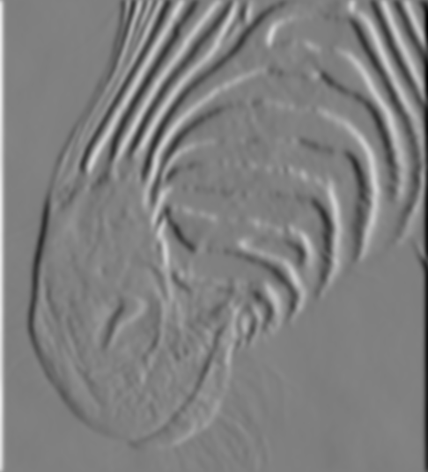
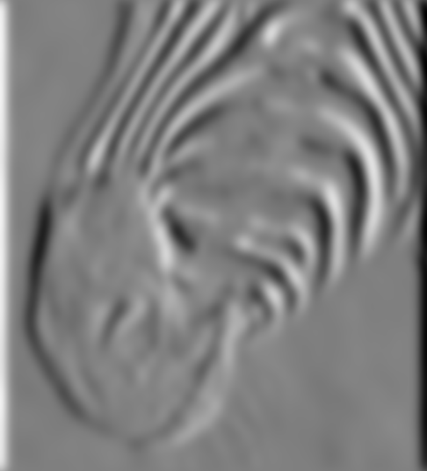
Scale of Gaussian derivative filter
1 pixel
3 pixels
7 pixels
Smoothed derivative removes noise, but blurs edge. Also finds edges at different “scales”.
Source: D. Forsyth

